Slide 1
Team 1
Electris Screen Recorder Protocol System

Slide 2
Introduction
Explainations of all the code and modules we used to create this application.
Pictures and the reason for each function in the system.

Slide 3
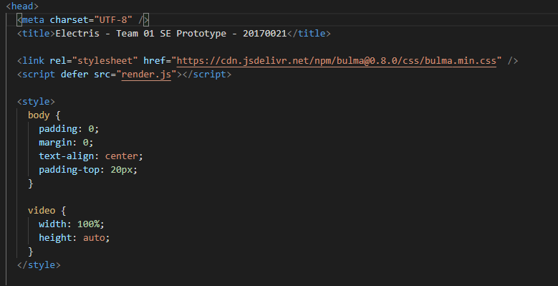
Home page index.html
We used html to create this page and to reduce work we combined css in the same file.

Slide 4
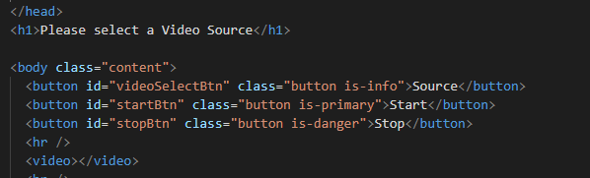
Buttons in html
WE created 3 buttons which are the main key of this system.
These buttons are Source button, Start button, Stop button.

Slide 5
Index.js
We then proceed to javascript with index js and here we created the size of our application pages and we create all the fuctionalities for a page to respond.

Slide 6
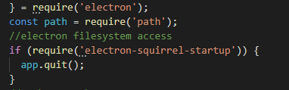
The first fuction is electron
This jfuction is the one which will start up the page , its main aim is the filesystem access.

Slide 7
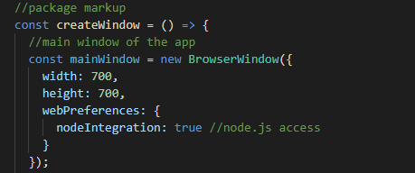
This is the main window of the Application
We set the window size to (700 by 700 ) since it can fit all the screen sizes available.

Slide 8
Connecting index.html and index.js
This is the template engine loader function that we use to import the index html file .

Slide 9
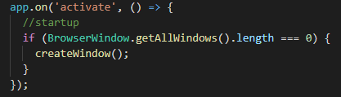
Starting the App
We then used this function to start up the app

Slide 10
Render.js
For our application to do the job , we used rendering which is a module which comes in electron with some min-modules.

Slide 11
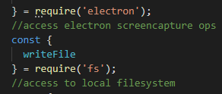
Electron
Electron is a powerful module which is used for many tasks during the life of our computers.
It is used for video record with the right min-modules which comes with it and some which works side by side with it.
In our application we used for screen capturing ops

Slide 12
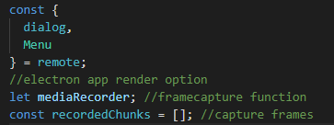
Render option & Capture frames
We used these function to make the electrons to start recording the screen using rendering method, also known as capturing the frames.

Slide 13
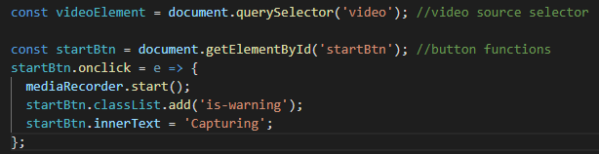
Select source
To select a source you need to record we used this command , thanks to Mr Neloy for the idea.
After recording to transfer the information to the capturing state we used the secnd command.

Slide 14
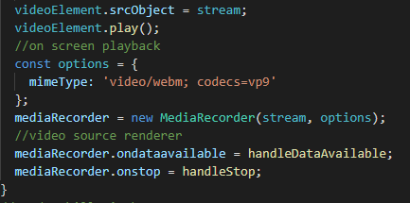
saving the captured video
we used webm since it is the one which is supported by all system's.

Slide 15
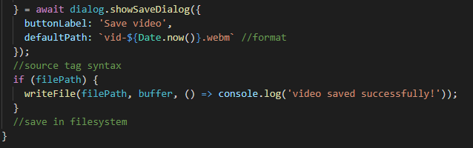
Saving the video
We then used this command to save the video, it automatically save the file with date and current time (format)
The function for saving and exiting the file system .

Slide 16
Dependencies
We used some dependencies to make sure our application runs fine.

Slide 17
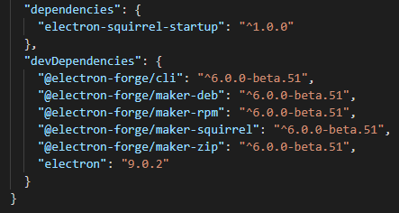
dependencies.
We used these dependencies for different set of operations.
Every dependency played a huge role to make this application works

Slide 18
A great thanks to my lecturer:
Mr Dandelion

